Slide 1
November 21, 2024
SUDOKU
SOLVER
A Project by
Abhinav Bitragunta
Aman Gupta
Srinidhi Sai Boorgu
Ansh Jain

Slide 2
IMAGE CREDITS
All images with a ‘*’ on the top right were taken from
reference 2 mentioned on our GitHub repository.
The rest were made by us.

Slide 3
INITIAL STEPS
Regular backtracking, O(n) search time
Regular backtracking using hash arrays, O(1) search
Regular backtracking, hashing with bits.
Looking for faster algorithms...

Slide 4
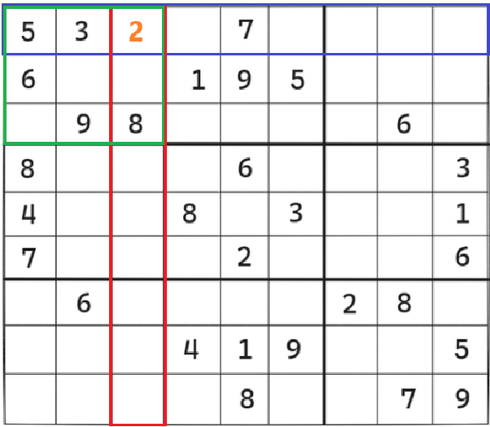

Slide 5
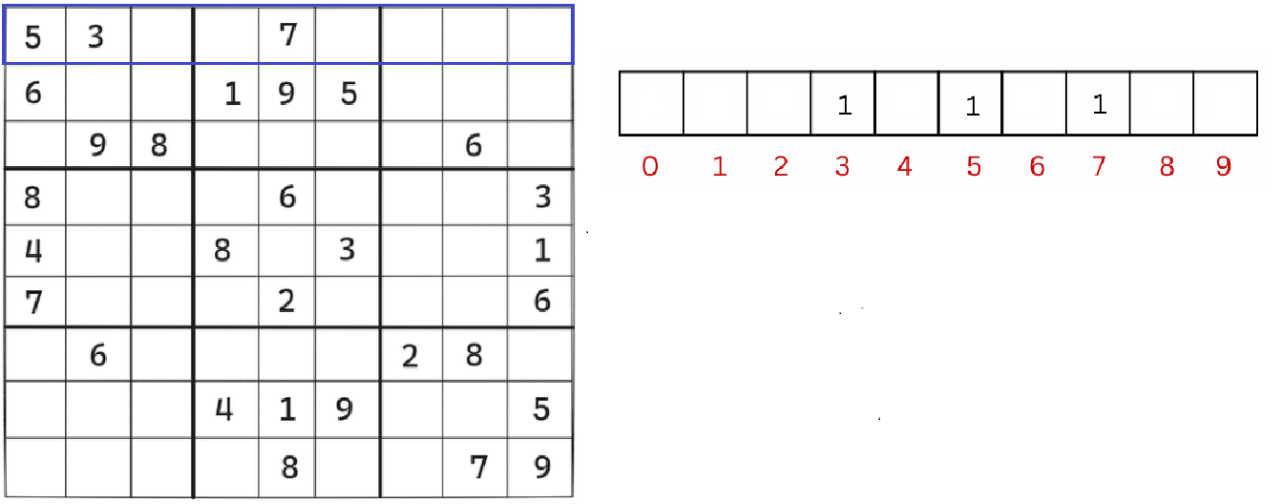
ARRAY HASHING

Slide 6
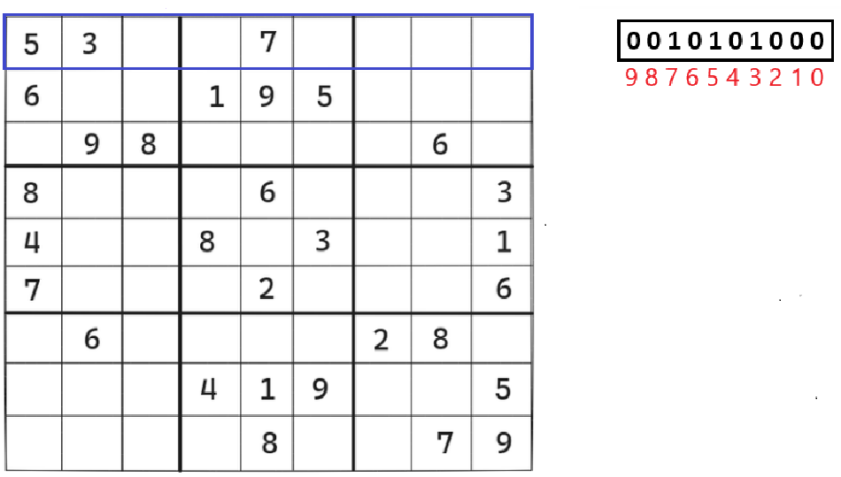

BIT HASHING

Slide 7
FASTER ALGORITHMS
Sudoku, being NP-complete, can be converted into other
NP-complete problems. Efficient algorithms that reduce the search space for these problems exist.
The exact cover problem is one such problem, and Donald Knuth’s ‘Algorithm X’ implemented using ‘Dancing Links’ is
a known efficient algorithm used to solve it.

Slide 8
THE EXACT COVER PROBLEM
Given a set S and another set where each element is a subset to S, is it possible to select a set of subsets such that every element in S exist in exactly one of the selected sets?

Slide 9
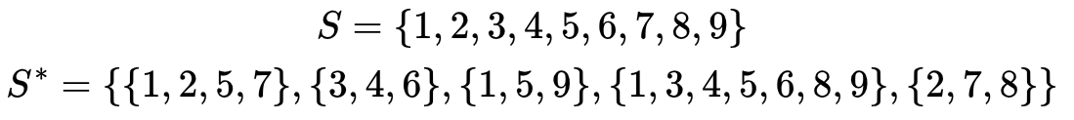
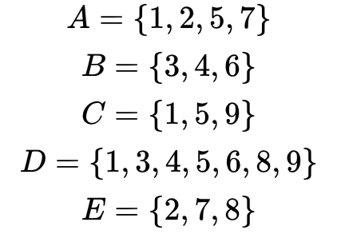

Slide 10
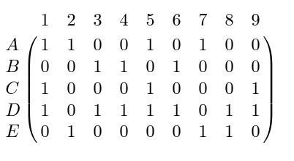
BINARY MATRIX REPRESENTATION
*

Slide 11
ALGORITHM X
*

Slide 12
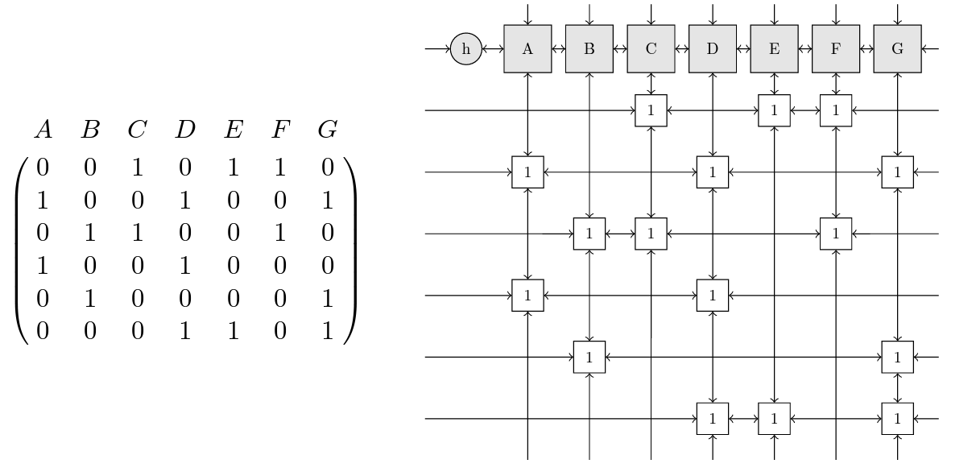
TOROIDAL LINKED LIST
*

Slide 13
CONVERTING BETWEEN
THE TWO
Convert
Solve
Convert back
Convert Sudoku into the exact cover problem
Identify constraints and solve using Knuth’s DLX
Convert solution into solved Sudoku format

Slide 14
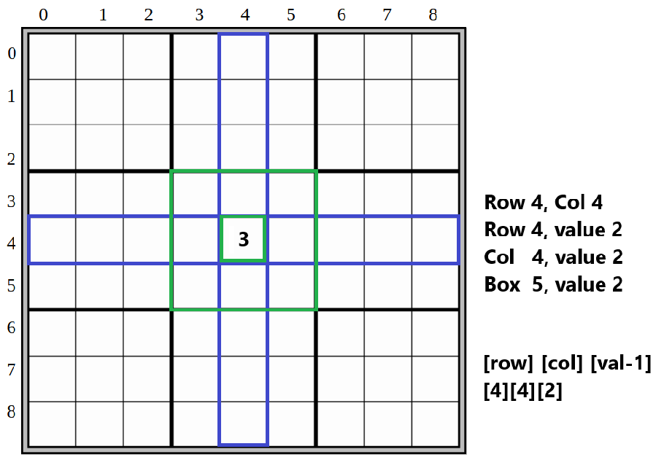

Slide 15
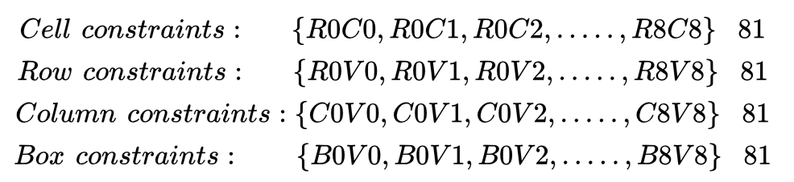

Slide 16
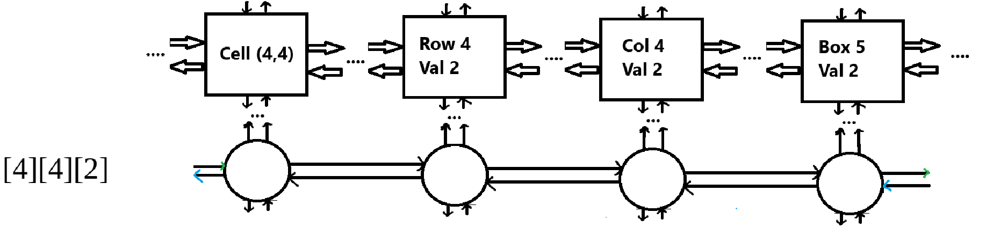

Slide 17
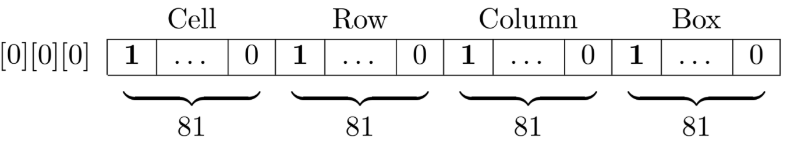
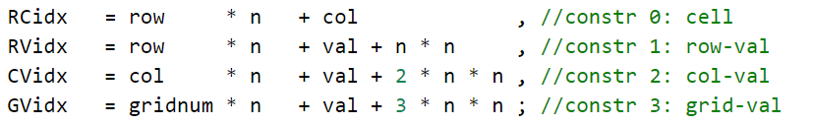
CONVERSION TO EXACT COVER
Represent a choice as [Row index][Column index][Value - 1]
*

Slide 18
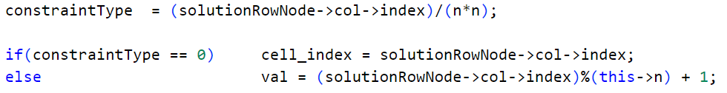
CONVERTING BACK TO SUDOKU

Slide 19
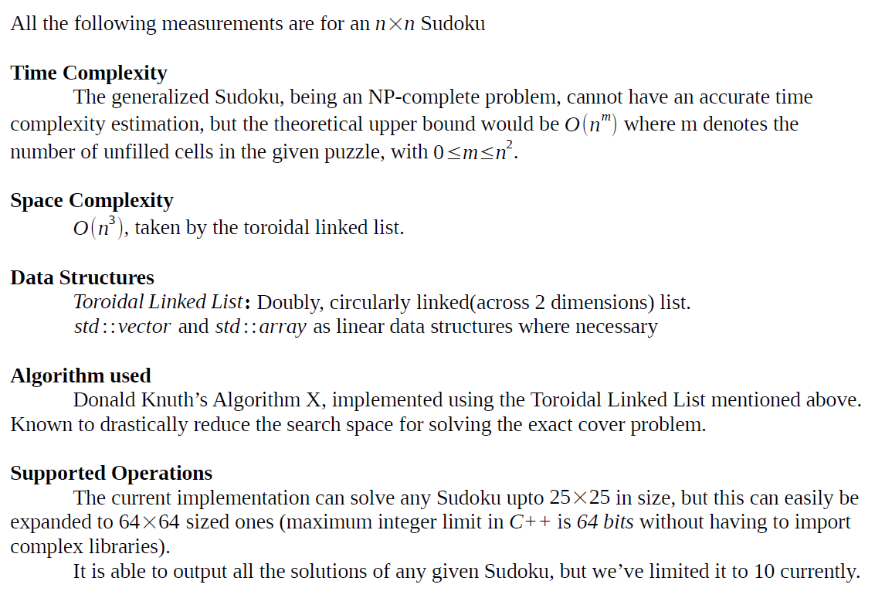

Slide 20
THANK
YOU

